Slide 1

Customer Churn
UCONN OPIM-5604-PREDICTIVE MODELING-FINAL PROJECT
GROUP 8B
SUPRAJA BALA, RYAN NELSON, ROHIT KAMINENI

Slide 2
Introduction
● What business value there might be from your findings and prediction. What business questions are you hoping to answer in your modeling work?
○ Based on this dataset, we will look into what type of customer has more likelihood to stop being a customer.
○ This data could potentially help enable the company to predict what customers will churn, and offer incentives to these customers in order to get them to stay, before they decide to leave.

Slide 3

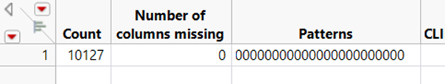
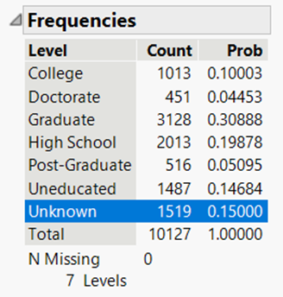
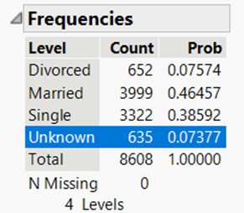
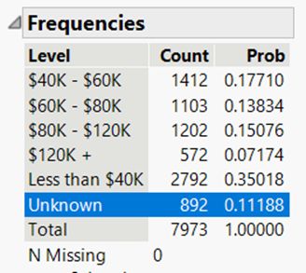
Data Cleaning:
Missing values

Slide 4
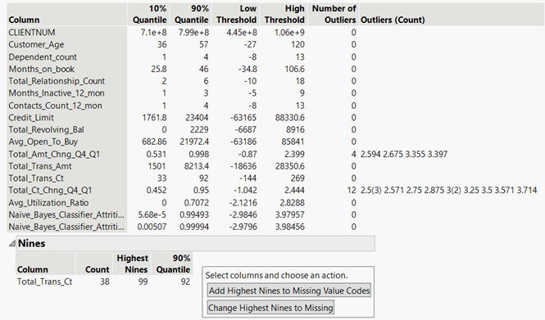
Data Cleaning:
Outliers

Slide 5
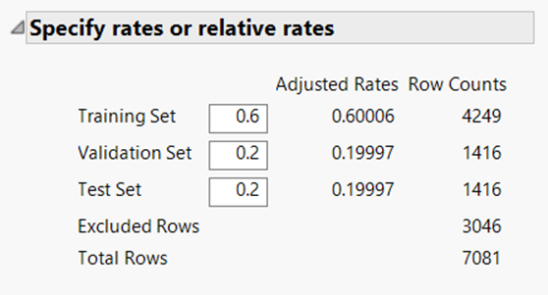
Data Cleaning:
Validation rows

Slide 6
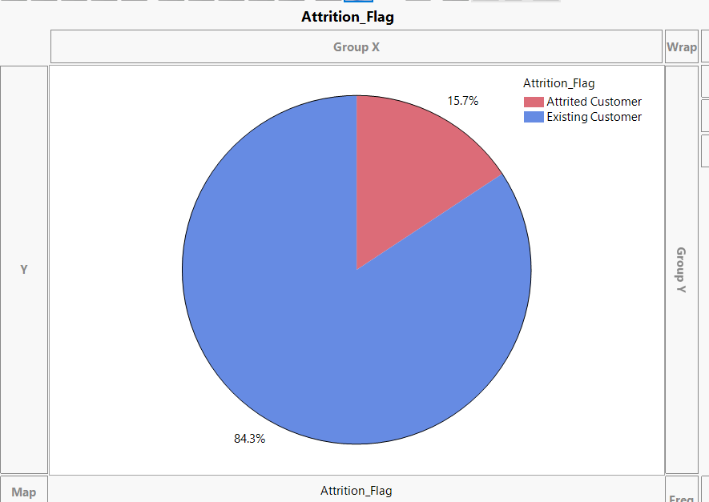
Data Exploration:
Churn Vs No churn
It’s evident from the graph that only 16% of the data samples represent churn customers

Slide 7
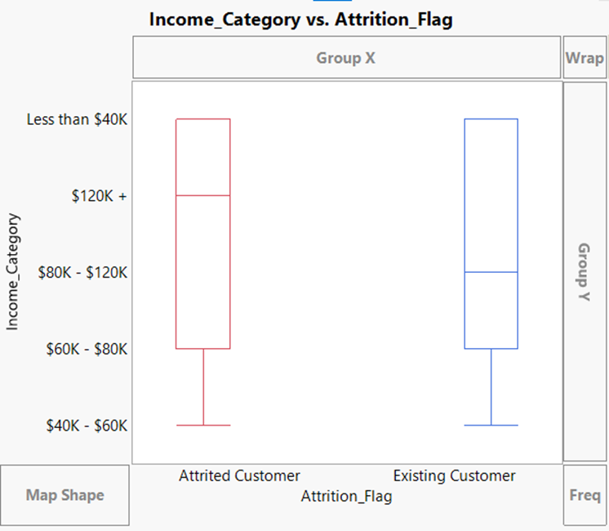
Data Exploration:
Interesting Findings

Slide 8
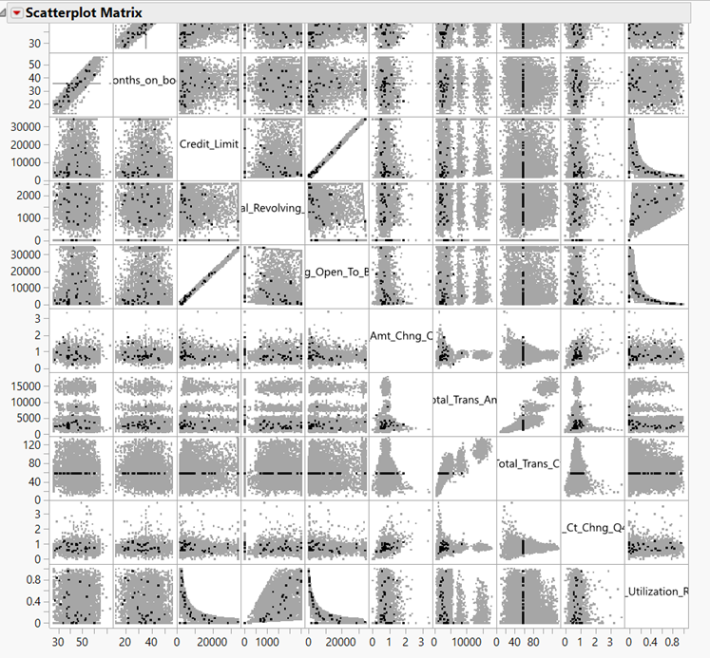
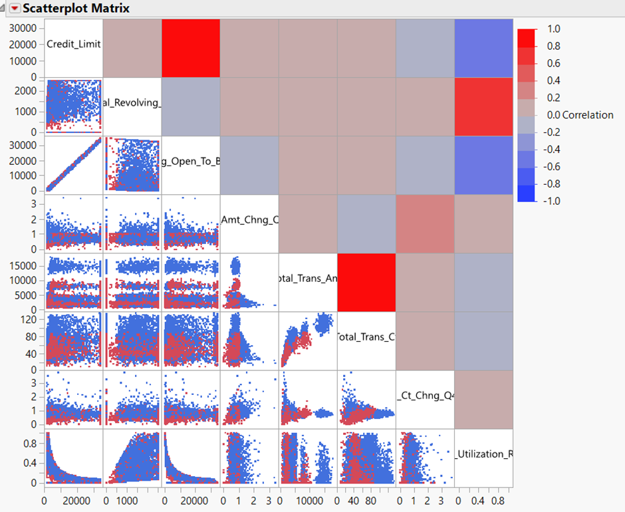
Data Exploration:
Multivariate Scatter plot

Slide 9

Model Selection
Selected Model: Neural network
2 Hidden Layers with 8 nodes each
Model | Total Accuracy | Accuracy of the 1 Prediction
Regression | 0.894662 | 0.585062
Naïve Bayes | 0.874733 | 0.680498
Decision Tree | 0.911032 | 0.684647
Discriminate | 0.849456 | 0.823899
KNN | 0.856227 | 0.282157
Neural Network | 0.939501 | 0.800829
 | Training | Validation | Test
Total Accuracy | 0.9701597744 | 0.95 | 0.9395017794
Accuracy of the 1 Prediction | 0.8655834564 | 0.7897435897 | 0.8008298755
Precision | 0.9421221865 | 0.8369565217 | 0.8391304348
Recall | 0.8655834564 | 0.7897435897 | 0.8008298755
AUC | 0.9917 | 0.9715 | 0.9803
Notes:
Speaker: Rohit Kamineni

Slide 10
Conclusion & Business Findings

Slide 11
Appendix
MODEL WORK

Slide 12
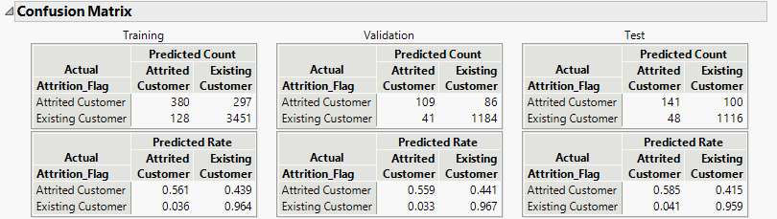
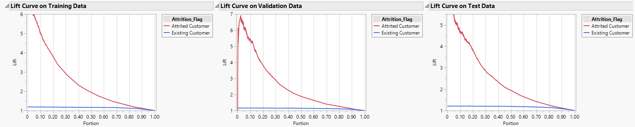
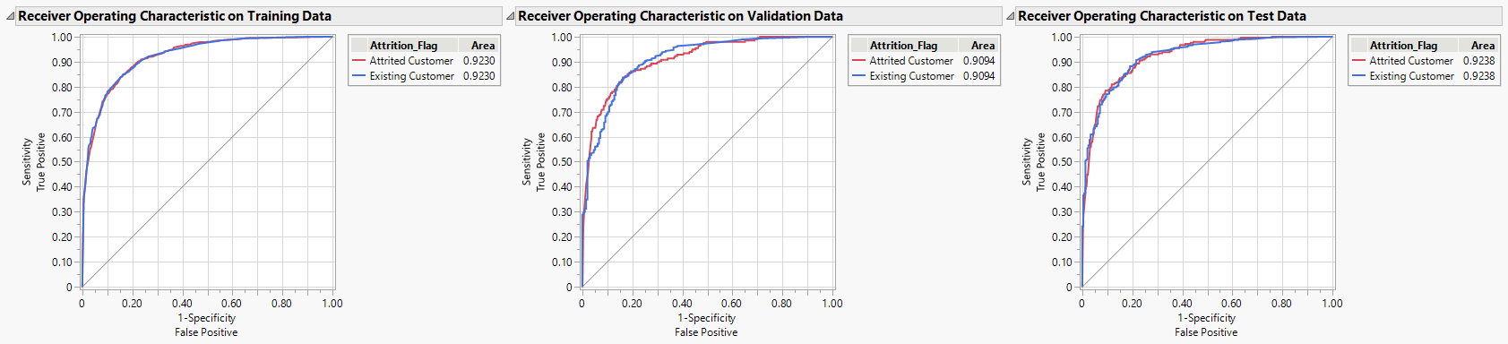
Regression
 | Training | Validation | Test
Total Accuracy | 0.90014 | 0.9105634 | 0.894662
Accuracy of the 1 Prediction | 0.5613 | 0.5589744 | 0.585062
AUC | 0.923 | 0.9094 | 0.9238

Slide 13
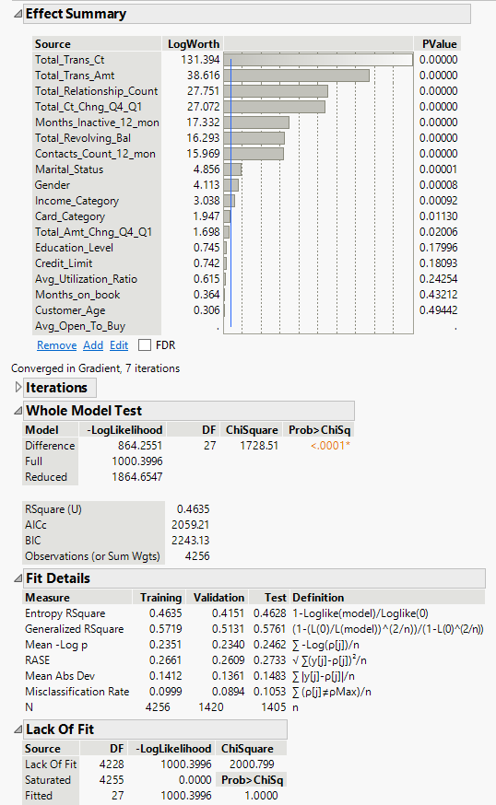
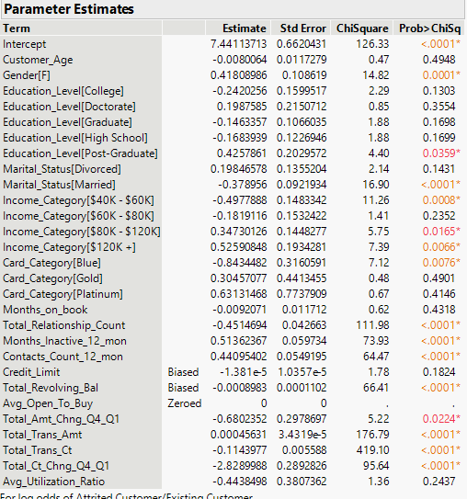
Regression

Slide 14
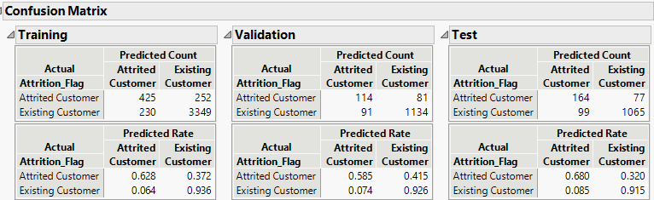
Naïve Bayes
 | Training | Validation | Test
Total Accuracy | 0.88675 | 0.8788732 | 0.874733
Accuracy of the 1 Prediction | 0.62777 | 0.5846154 | 0.680498
AUC | 0.923 | 0.9094 | 0.9238

Slide 15
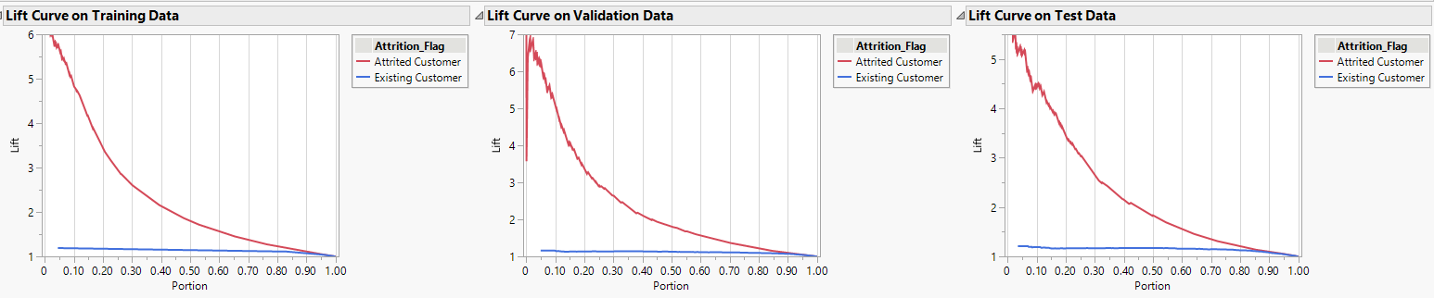
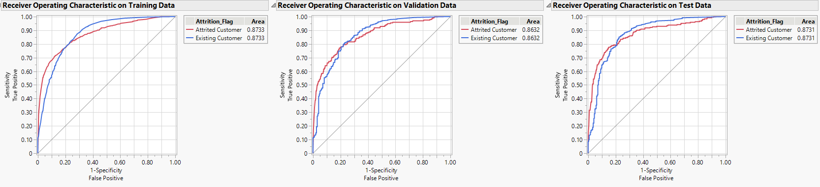
Naïve Bayes

Slide 16
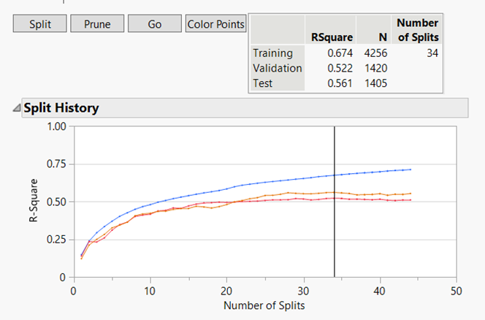
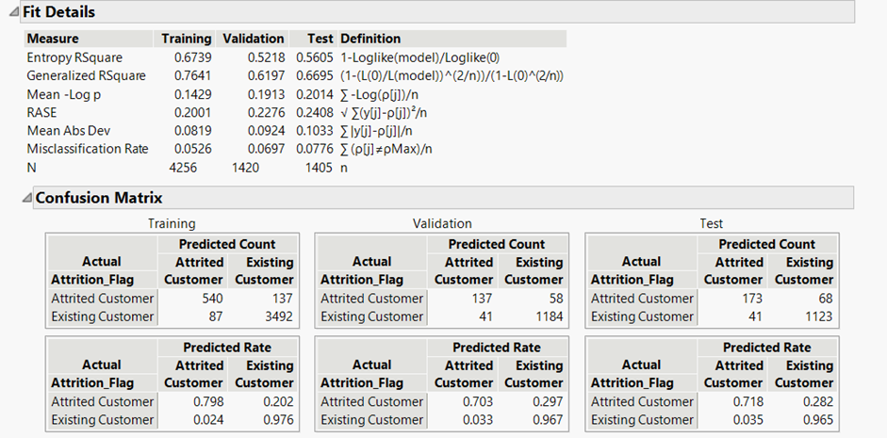
Decision Tree

Slide 17
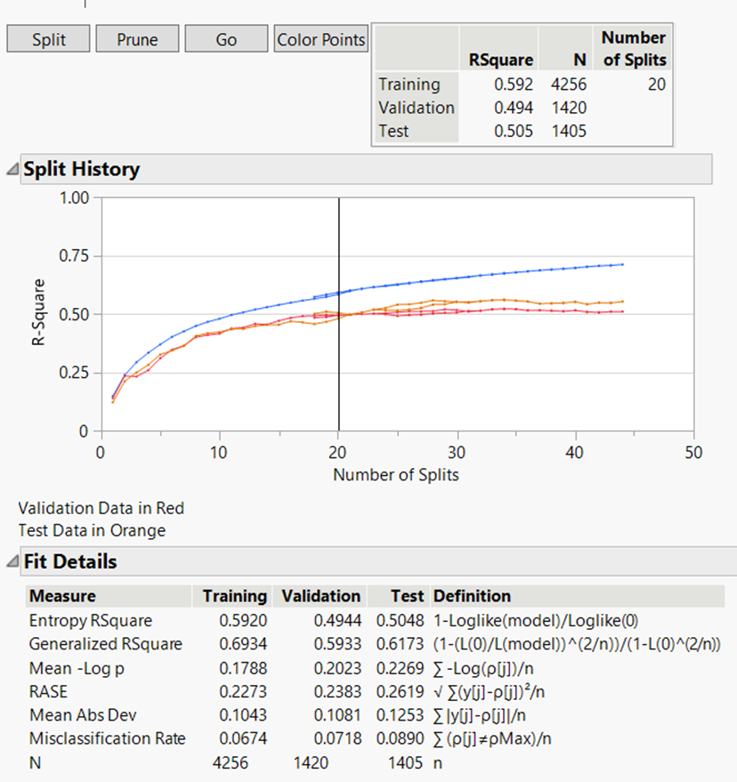
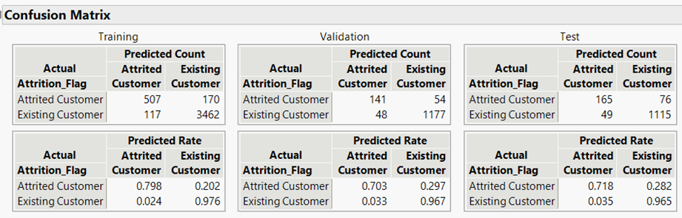
Decision Tree
 | Training | Validation | Test
Total Accuracy | 0.84946 | 0.928169 | 0.911032
Accuracy of the 1 Prediction | 0.8239 | 0.7230769 | 0.684647
AUC | 0.9535 | 0.9272 | 0.9366

Slide 18
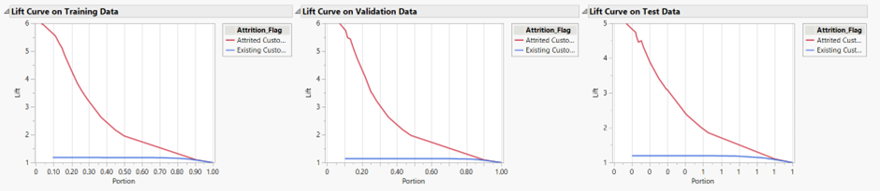
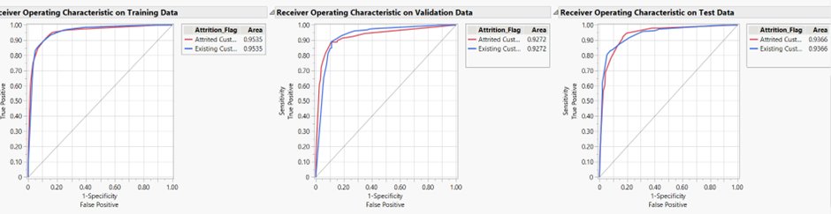
Decision Tree

Slide 19
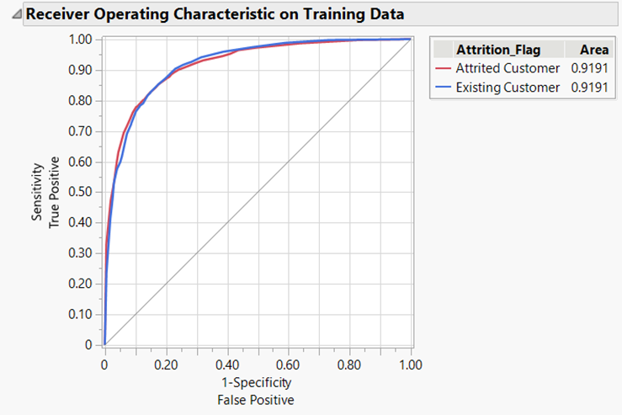
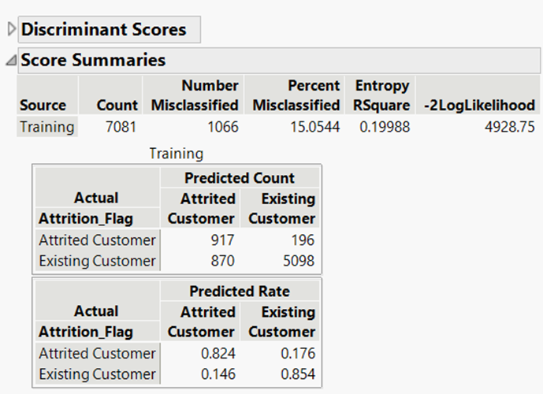
Discriminate

Slide 20
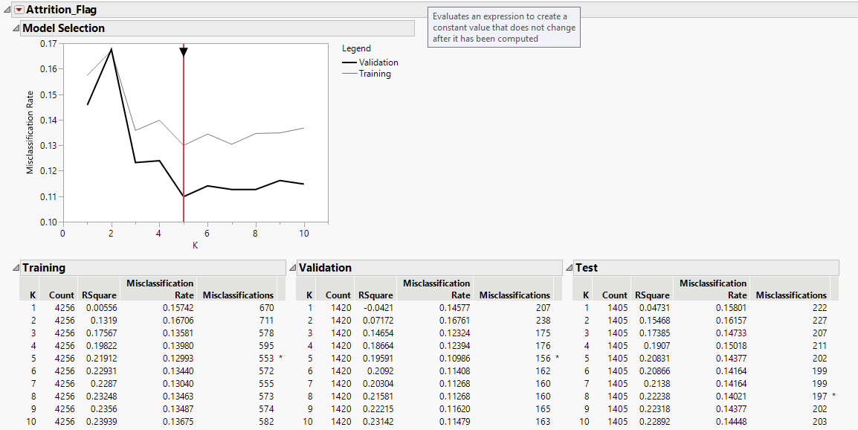
KNN

Slide 21
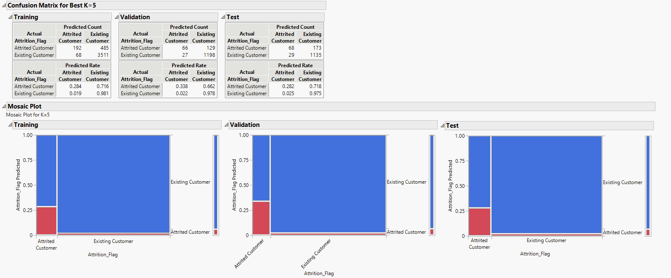
KNN

Slide 22
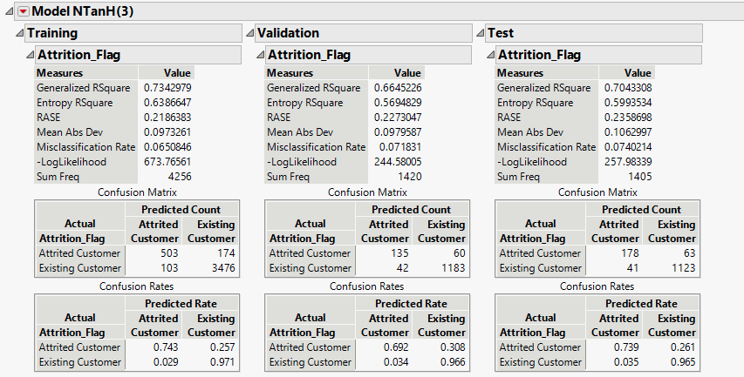
Neural Network
 | Training | Validation | Test
Total Accuracy | 0.9349154135 | 0.9281690141 | 0.9259786477
Accuracy of the 1 Prediction | 0.7429837518 | 0.6923076923 | 0.7385892116
Precision | 0.8300330033 | 0.7627118644 | 0.8127853881
Recall | 0.7429837518 | 0.6923076923 | 0.7385892116
AUC | 0.9685 | 0.959 | 0.9602

Slide 23
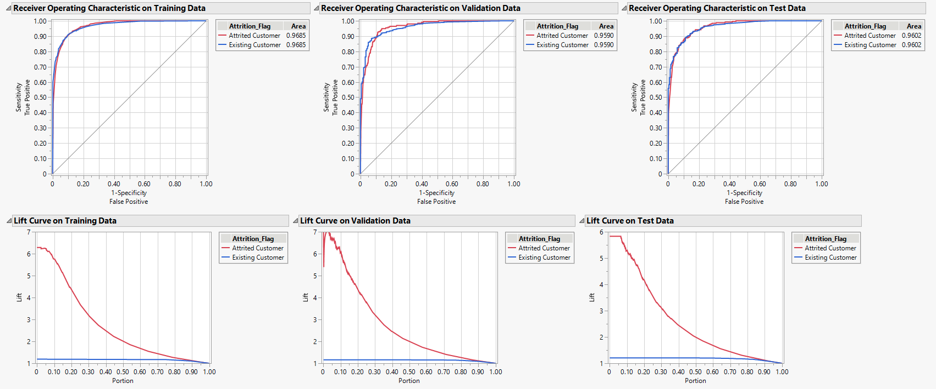
Neural Network

Slide 24
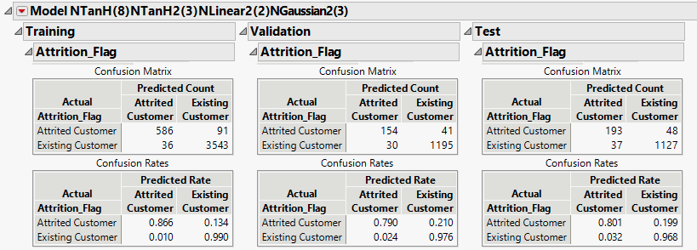
Neural Network
 | Training | Validation | Test
Total Accuracy | 0.9701597744 | 0.95 | 0.9395017794
Accuracy of the 1 Prediction | 0.8655834564 | 0.7897435897 | 0.8008298755
Precision | 0.9421221865 | 0.8369565217 | 0.8391304348
Recall | 0.8655834564 | 0.7897435897 | 0.8008298755
AUC | 0.9917 | 0.9715 | 0.9803

Slide 25
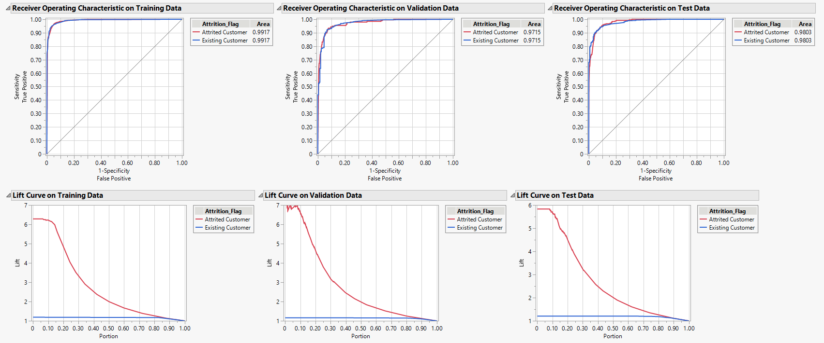
Neural Network

Slide 26
References
Dataset: https://www.kaggle.com/datasets/sakshigoyal7/credit-card-customers

